Slide 1
GeoSocInt
Geo-Spatial Social Intelligence
Team Jarvis2.0

Slide 2
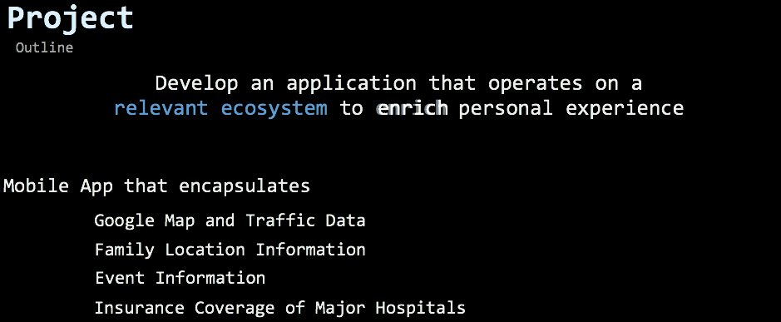




Friends
Couples
Your Family is Important
Being Together is Important
Preparedness Is Important
Our App Brings it All Together
Children
Extended Family

Slide 3
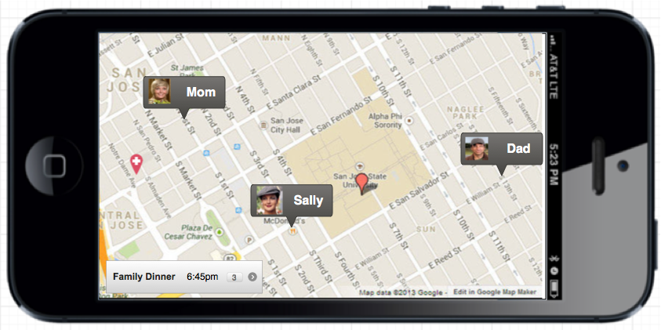
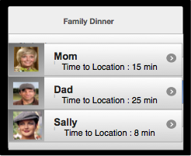
Using Location Services, GIS, Traffic and Event Data
The App
We bring everyone together on one App
On Time
Prepared for emergencies

Slide 4
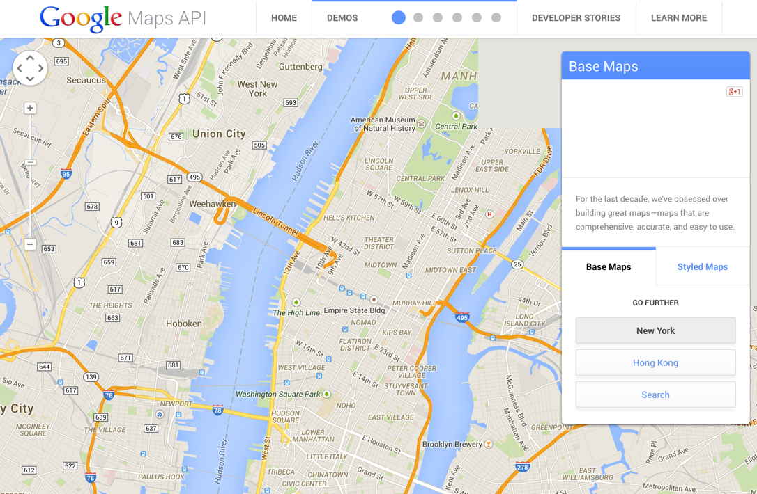
Technology Build Out Approach Methodology
Google & Traffic
Google Maps
Web mapping service integrated with other data analysis applications
Route planning
Provides an API
Overlay data into a customized Google Map
Elevation profiles
Demographics
Place database

Slide 5
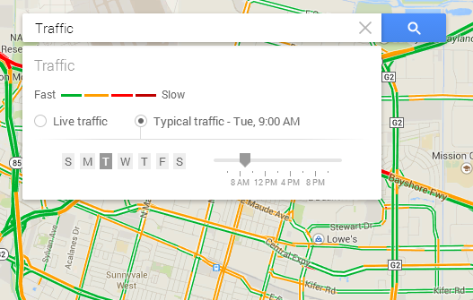
Technology Build Out Approach Methodology
Google & Traffic
Traffic Data
Harnessing current traffic data with location travel notifications
Google API Traffic Layer
Given route
Usual traffic patterns
Live Traffic analysis
Travel Time suggestions

Slide 6
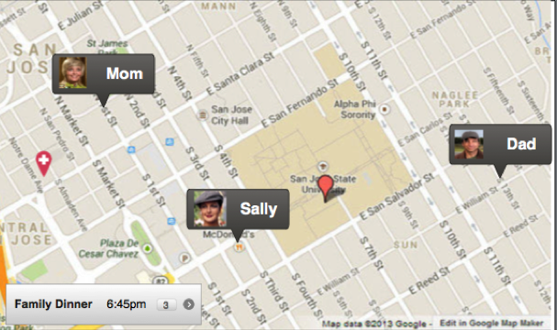
Technology Build Out Approach Methodology
Realizing Location Services
Group Opt-In
Provision of mapping of the location of all members in the group plan.
Streaming Position Updates
Geometrical information mapping
Absolute geometry
Official coordinate system
Relative geometrical
Unique
Non-Redundant
GPS Display
GPS Layer
Official coordinate system
Custom Graphics Layer
GPS Event Listener

Slide 7
Technology Build Out Approach Methodology
Features
Events
Coordination along with reminding and notification of events to users and members that are opt-in.
Event Pop-up
Timely suggestions
Analysis of live traffic streams and routes.
Insurance Geo Mapping
Provision of medical centers and hospitals based on members insurance policy.
Family Organizer
Subscribes to insurance data
Pre-scheduled appointments
Reminder popups

Slide 8
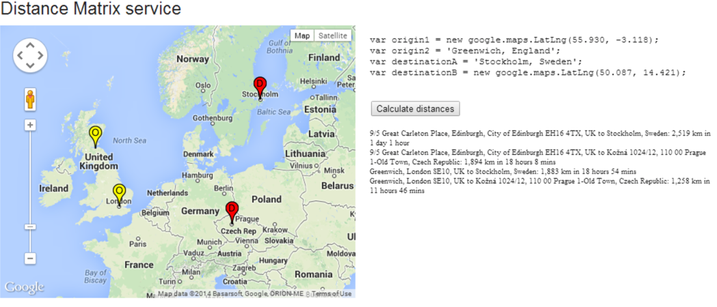
Technology Build Out Approach Methodology
Multi Level Mapping Services
Google Map Navigation
Single Level Marker
Unique geocoded location
Point level precision
Latitude and longitude assignment
Multi Level Marker
Integration of multiple locations into one unique map-set
Google Distance Matrix Service and Direction Service
Origin-destination pairs
Asynchronous
Call back method
Application will need to send origins and destination pairs

Slide 9





Slide 10

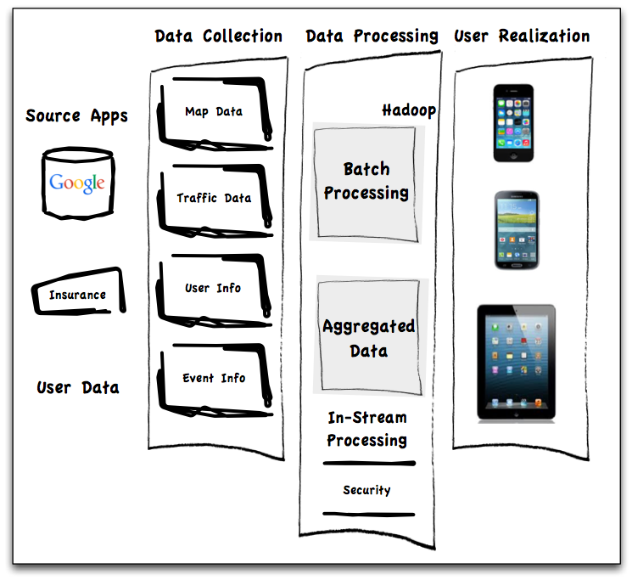

Slide 11
Technology Build Out Approach Methodology
Conway Methodology
Mel Conway - 1967
Organizations develop systems in the manner in which they communicate internally.
The system boundaries during the design activity
Supporting systems organization in order so that the design groups can be meaningfully assigned
Coordination problems occur across the task groups working on a unified system design
Important for the Application Development
Interface Compatibility
3rd party data, analytics team, performance
Different teams need to be integrated during design
One common purpose and language

Slide 12
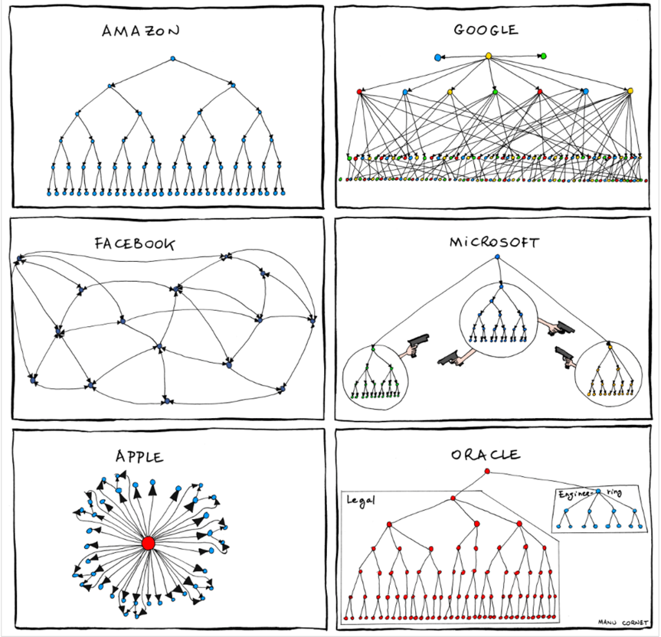
Technology Build Out Approach Methodology
Conway Visualization
System design approach will mimic organizations
Manu Cornet
Notes:
Development teams need to be organized in a way that facilitates good design. Which design team would you not want to work on?

Slide 13
Technology Build Out Approach Methodology
Approach Methodology
Big data choices
New technologies evolving quickly
Passing trends
Ecosystem is crowded
Technologies Overlap
SQL vs. NoSQL vs….

Slide 14
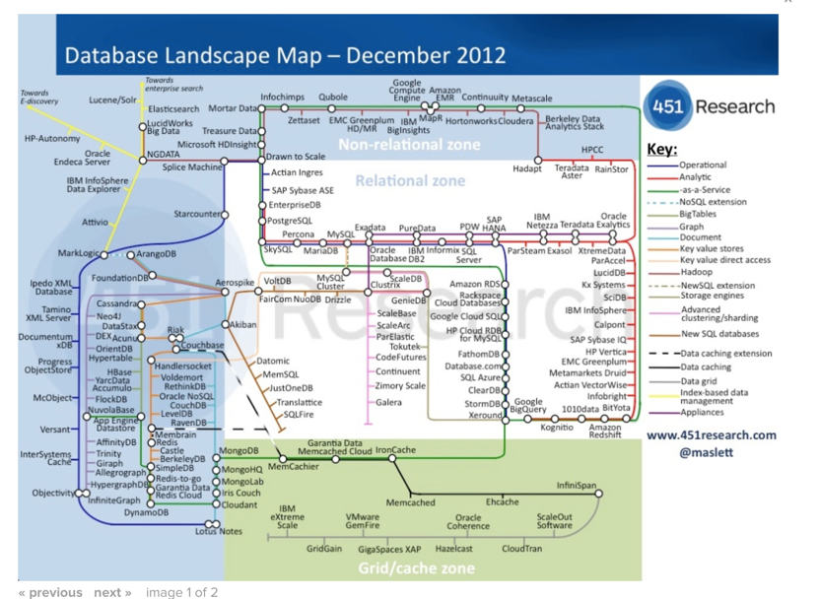
Technology Build Out Approach Methodology
Approach Methodology
Notes:
Confusing landscape even back in 2012 – Which technology do you choose?

Slide 15
Technology Build Out Approach Methodology
Approach Methodology
Notes:
Our application will use a blended approach for DB support depending on the specifics of the design critieria.

Slide 16
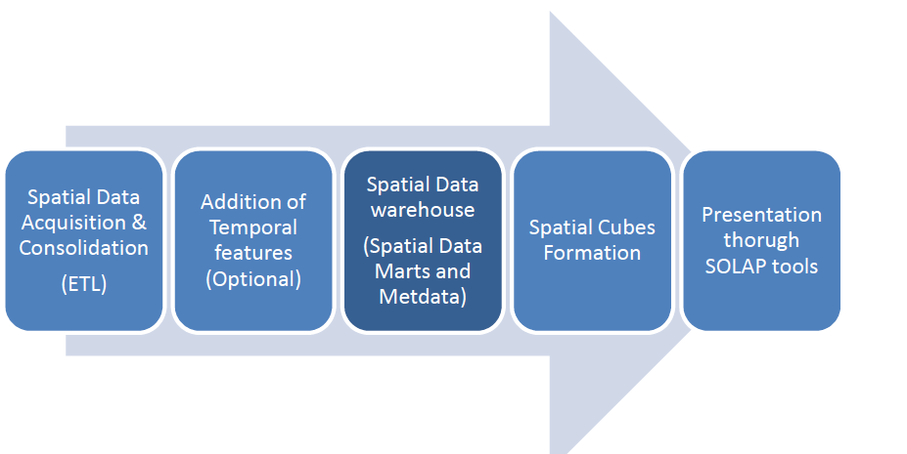
Technology Build Out Approach Methodology
Spatial Warehousing
"Spatial OLAP can be defined as a visual platform built especially to support rapid and easy spatiotemporal analysis and exploration of data following a multidimensional approach comprised of aggregation levels available in cartographic displays as well as in tabular and diagram displays." Bédard, 1997.

Slide 17
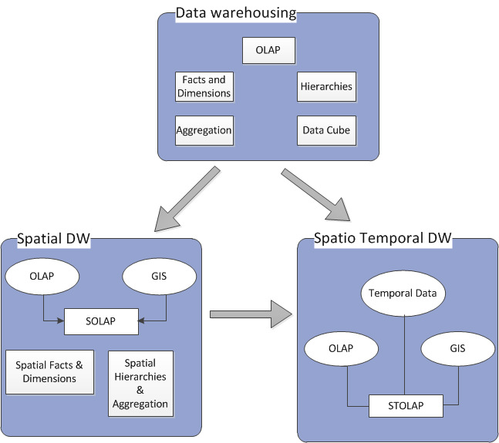
Technology Build Out Approach Methodology
Spatial Warehousing
SOLAP – Hybrid for GIS
Swifty answer multi-dimensional analytics (MDA).
Intuitive data warehousing
GIS provides cartographic representation
OLAP provides multidimensional perspective

Slide 18
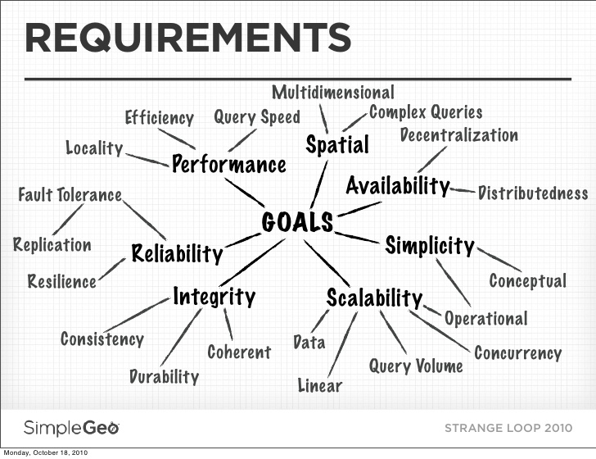
Requirements :

Slide 19
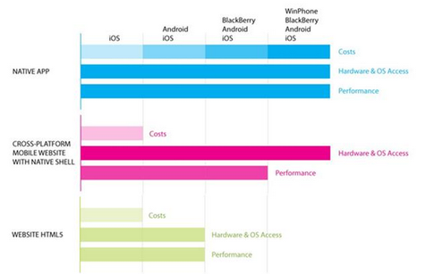
Technology Build Out Approach Methodology
Design Considerations
3 options of mobile application development:
Native app: Mobile apps built for specific platforms like iOS, Android, Blackberry.
HTML5 Web App: Mobile optimized websites that appear to be apps and run on the mobile browser
Hybrid/ Cross- Platform App: Single mobile app built on HTML5 and optimized for multiple platforms (using native containers).

Slide 20
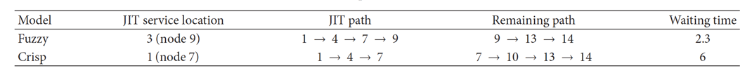
Algorithms
Mad Science
Autoregressive Integrated Moving Average (ARIMA)
Time Series analysis statistic
Fitted for a generalization to predict future points in a series.
Data mining to ensure good marker relation to event coordination
Fuzzy Integer Programming
This ambient intelligence (AmI) features a processing that is interconnected and dynamic. Fitted for a generalization to predict future points in a series.
One limitation of this was to create this system that is location aware (LAS) which is an innovation on the AmI schema.
The modeling can improve the just in time (JIT) arrival of time series analysis

Slide 21
Security Requirements
Full Disclosure
Consumer security in the era of the mobile platform is of pivotal concern.
The concern here is that the consumer may be unable to judge whether location data shared with these sites are trustworthy
Over time individual behavior can be derived from this information and potentially exploited.
The application will ensure consumer security by these guidelines:
Privacy Policies
Terms of Service Agreements
On Screen Notification
User Controlled methods to end data collection
User requested deletion of data

Slide 22
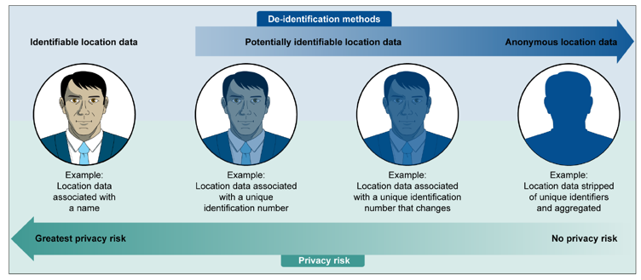
Security Requirements
Full Disclosure
Data collection methodology is the ability link the information to a specific individual identifiable through personal identifiable information (PII).
Individual can be identified and then linked to the data set, vs. anonymized data in which no personal identifiable information can be obtained.

Slide 23

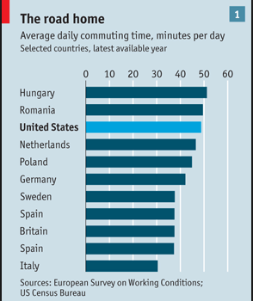
Sales Conversion Rates Increase - More On-boarding
Improved customer satisfaction
User experience is enriched
Save Money
Save Gas
Options for car pooling
Improve the Quality Of Life of the participants
More time with family and friends
Health care Integration
Emergency response in case of issues to facilities under your insurance
On Average if the App can save
1 person being late to pick up a
Child from day care, the overall combined
Savings would be :
(10 minutes per day * 5 days per week * 50 weeks) = 43 hrs per year spent
With family.
This does not include savings from late pick up fees!

Slide 24
Member Contributions :
Lizabeth : Architechtural Approach, ROI
Sandyarathi : Database Design, SOLAP-GIS
Kovid : Multilevel Mapping Integration, Fault tolerance management
Gaurav : Real-Time Processing Algorithms, Consumer Security

